Slide 1

Rockbuster Stealth Data Analysis Project
By Harry Maione
07/15/2022

Slide 2
Objective
To stay competitive with streaming services by using its existing movie licenses to launch an online video rental service.
Key Questions
Which movies contributed to the most/least to revenue gain?
What was the average rental duration?
Which countries are customers based in?
Where are customers with high lifetime value based?
Do sales figures vary between geographic regions?

Slide 3
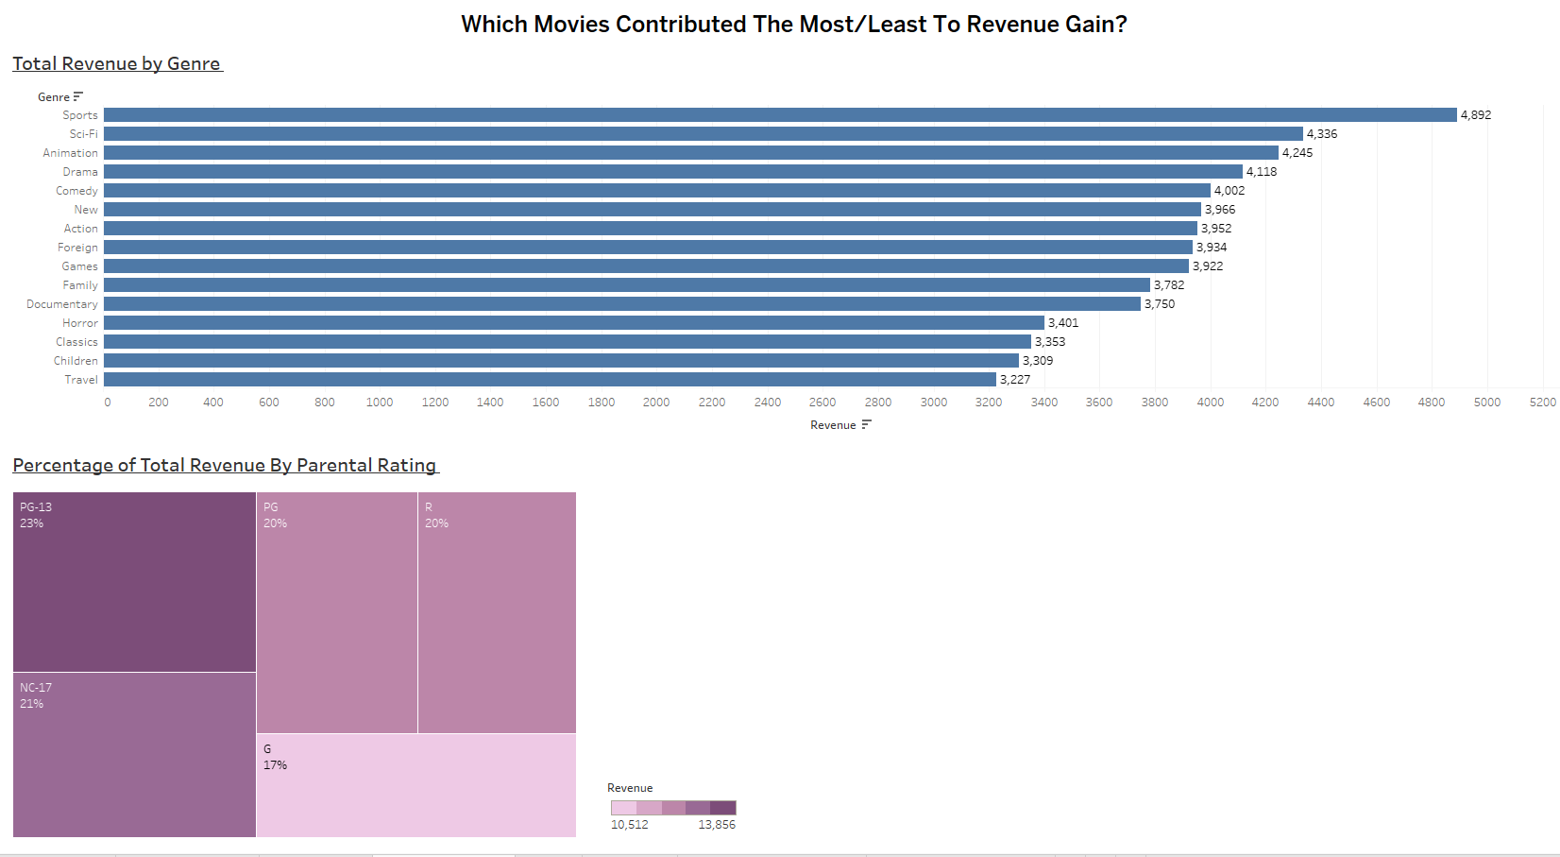
1.Revenue appears to be spread out amongst different film genres.
2. Customers are renting movies from all parental rating groups.

Slide 4
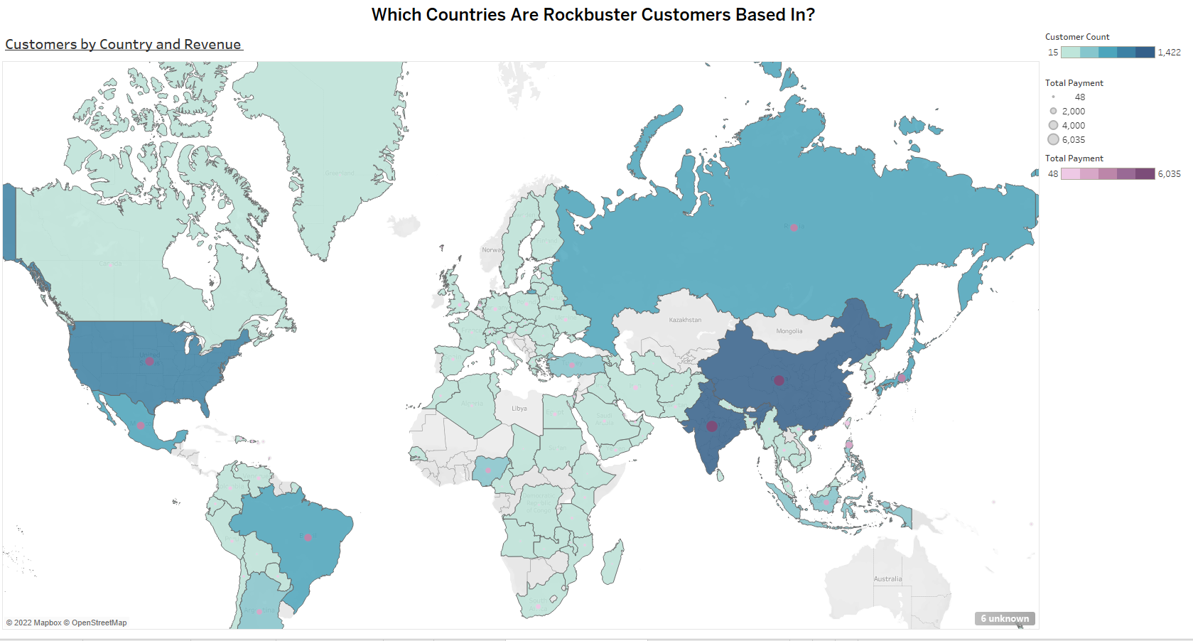
The United States, India and China lead the way in amount of customers and total revenue.

Slide 5
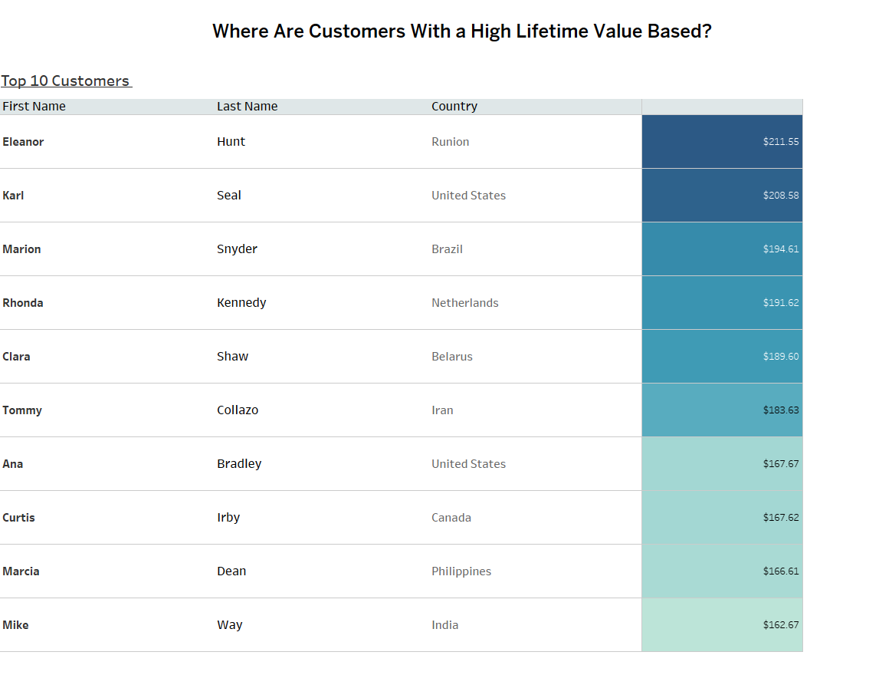
Our loyal customers come from different countries around the world.

Slide 6
Conclusions
Recommendations
1. While genres such as Sports and Sci-fi and parental rating groups like PG-13 and NC-17 are most popular; revenue appears to be distributed amongst all sectors.
2. We are most popular in China, the United States and India.
3. Our loyal customers are located all around the world.
Continue to leverage licensing agreements while seeking exclusivity.
Consider creating original content only available on Rockbuster Stealth.
Continue to market in locations that produce the best results.
Consider creating a Rewards programs for loyal customers.

Slide 7

Further Questions?
Email harry.maione@rockbuster.com

